Slide 1

KUNST
CLIL
Do Coyle
University of Nottingham ~ Aberdeen (September)
Goethe Institut Glasgow
August 2008

Slide 2
CLIL
KUNST
    So what is CLIL?
  How can CLIL promote Curriculum
  for Excellence?
  Linking Expressive Arts & MFL
  Examples of CLIL
  Getting started…….
http://uk.youtube.com/watch?v=cZRCKZ_RNq0

Slide 3
QUALITY LEARNING ENVIRONMENTS
Curriculum for Excellence
If you want to improve the quality of teaching, the most effective place to do so is in the context of a classroom lesson… The challenge now becomes that of identifying the kinds of changes that will improve student learning…of sharing this knowledge with other teachers…
Stigler, J & Hibbert, J (1999)
The Teaching Gap

Slide 4
A paradox
In subject matter learning we overlook the role of language as a medium of learning, and in language learning we overlook the fact that content is being communicated.
Mohan, 1986

Slide 5
What is CLIL?
CLIL is a developing, flexible concept where content (eg non-language subject/s, cross-curricular themes and holistic issues) and foreign languages - are integrated in some kind of mutually beneficial way so as to provide motivating, value-added experiences to educational outcomes for a wide range of students.
University of Nottingham

Slide 6
What is CLIL?
Content and Language Integrated Learning ……….
is not a panacea but an alternative means to providing opportunities for students to use language to learn rather than learning to use languages which is the core task of language lessons.
Using language to learn as well as learning to use language

Slide 7

A model for integration in CLIL
content
language

Slide 8
QUALITY LEARNING ENVIRONMENTS
Curriculum for Excellence
Too much attention is directed towards finding the ‘best method’, even though fifty years of educational research has not been able to support such generalisations. Instead, we should ask which method or combination of methods is best for which goals, which students and under which conditions
Dahllof, U (1999)
Towards a new model for the evaluation of teaching

Slide 9
QUALITY LEARNING ENVIRONMENTS
Curriculum for Excellence
Requires a re-conceptualisation from language learning per se towards an integrated model which actively involves the learner in using and developing language of, for and through learning
Promotes collaboration and reflection beyond language competence between subject teachers and language teachers to create CLIL environments
Demands teachers systematically plan for, teach, monitor and evaluate what they are doing with their learners BUT in collaborative networks and communities not as solo pioneers.

Slide 10
Expressive Arts ~ German
Curriculum for Excellence
Successful Learners
Confident Individuals
Responsible Citizens
Effective contributors
How can Content and Language Integrated Learning contribute to engaging young people in the highest quality learning activities and maximising their success?

Slide 11
A 4Cs Approach to Integrated Curriculum Planning
Communication
CLIL
Culture
Content
Cognition
Teaching and Learning through a foreign language

Slide 12
Original Terms New Terms
Evaluation
Synthesis
Analysis
Application
Comprehension
Knowledge
Creating
Evaluating
Analysing
Applying
Understanding
Remembering
(Based on Pohl, 2000, Learning to Think, Thinking to Learn, p. 8)

Slide 13
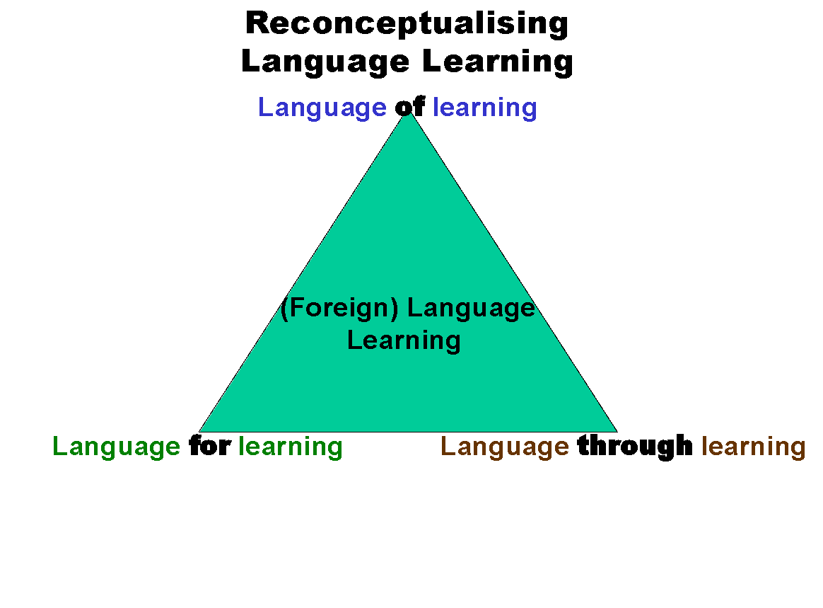

Slide 14
Using a matrix for quality audit
High cognitive
3 4
High Low
Linguistic Linguistic
2 1
Low cognitive
http://www.youtube.com/watch?v=dzKp97SjWD4

Slide 15
CLIL Potential for Curriculum for Excellence and beyond
Revisits effective teaching/ learning
Provides new challenges
Raises our expectations
Challenges our learners
Motivates learners
Elevates our subject
Develops different kind of language
Makes us ask What? How? Why?
Allows teachers to ‘own’ the process

Slide 16
Art & Foreign Languages
How will a CLIL approach meet the following?
Enable my learners to experience the magic, wonder and power of the arts X
Be enhanced and enriched through partnerships professional art companies, creative adults, and cultural organisations X
Recognise and nurture creative talentsX
Provide opportunities to deepen understanding of culture in Scotland and the wider worldX

Slide 17
Art & Foreign Languages
How will a CLIL approach meet the following?
Raise awareness of the skills required to be an effective learner of languages X
Raise awareness of social, cultural and geographical aspects of the countries where a particular language is spoken X
Develop knowledge about the language structure that allows the learner to check the accuracy of her/his language use and to create new language X
Promote the ability to communicate in relevant and realistic contexts. X

Slide 18
A 4Cs CLIL Planning Mind Map
Content
CLIL Module
Art through German
Cognition
Communication
Culture

Slide 19
Tried and Tested Module Ideas
CLIL
KUNST
  Primary
  Using colour theory
  Secondary
  KinderKunst
  Who decides?
http://uk.youtube.com/watch?v=cZRCKZ_RNq0

Slide 20
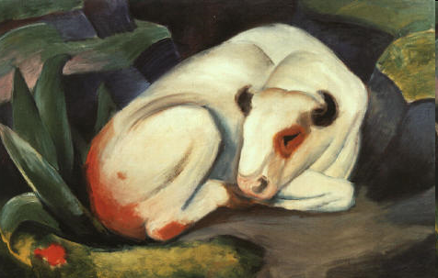
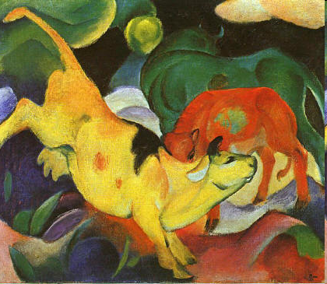
Ausstellung fuer Kinder
Franz Marc
http://www.youtube.com/watch?v=rEroJSYjDwo
http://www.youtube.com/watch?v=mZjidAomAvc&feature=related
http://www.youtube.com/watch?v=A7YdHKC6xsU&feature=related

Slide 21
Four planning stages for CLIL
V
vision
Context
Your school
Unit Concept
Mind Map:
Teaching Aims-Learning outcomes
Lesson Level
Task types use mind map
materials, assessment cycle

Slide 22
Four stages for successful CLIL planning
Stage 1: CLIL Vision
What do I want to achieve for our learners, their school and myself - blue skies?
Stage 2: School Context
Who is available to develop CLIL - where, when and how?
What does my school CLIL team offer?
What is most appropriate for our learners, parents, area in relation to stage 1?

Slide 23
Four stages for successful CLIL planning
Stage 3: the MINDMAP
Working with a conceptual framework such as the 4Cs, what will a unit of work consist of? Which content do we select, what will be our teaching aims and learning outcomes? What are the kinds of feedback and assessment will we build into the process (formative, summative)
Stage 4: Task types, materials and resources
What kind of tasks and activities will achieve stage 3?
What materials and resources will we need to support these?
Mapping Curriculum for Excellence
Evaluating classroom practice

Slide 24
A 4Cs CLIL Planning Mind Map
Confident individuals
CLIL Module
Art through German
Successful
Learners
Effective
Contributors
Responsible
Citizens

Slide 25
A CLIL Module Audit Mind Map
Once upon a
time
Confident
Individuals
evidence
Effective
Contributors
evidence
Successful
Learners
evidence
Responsible
Citizens
evidence
Other Outcomes
http://www.youtube.com/watch?v=2IFzp2cBA5g&feature=related

Slide 26

http://www.youtube.com/watch?v=2IFzp2cBA5g&feature=related

